Slide 1
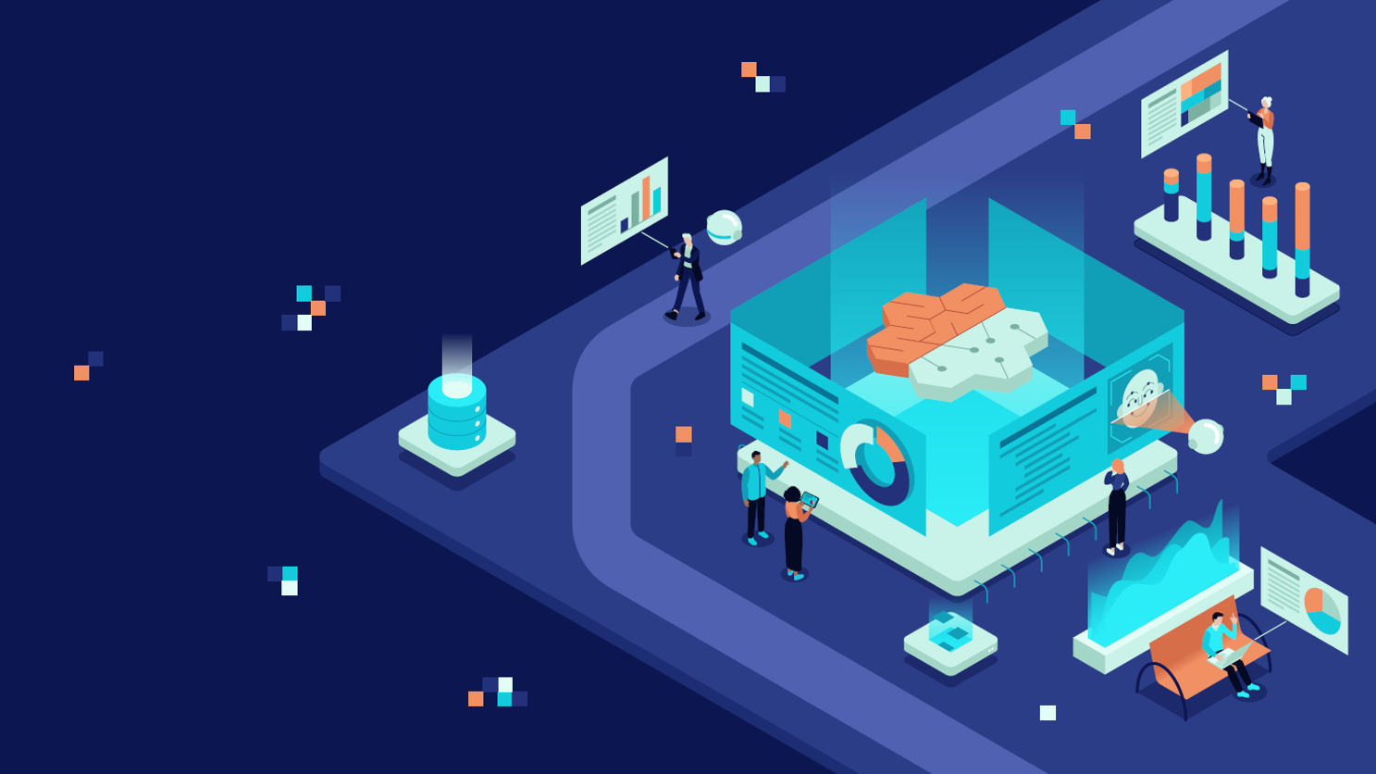
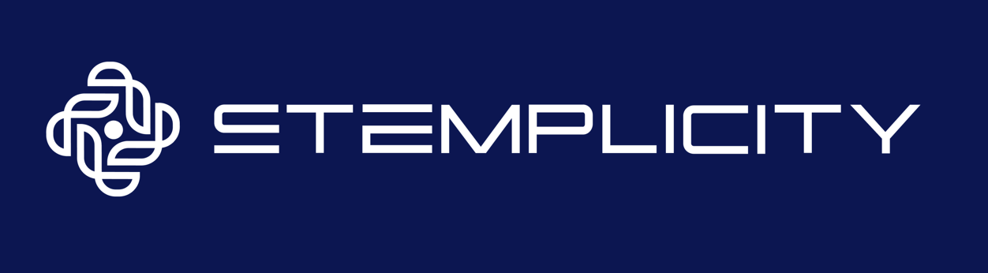
BUILD AN ADVANCED TUTOR USING MODEL CONTEXT PROTOCOL (MCP) & OPENAI AGENTS SDK

Slide 2

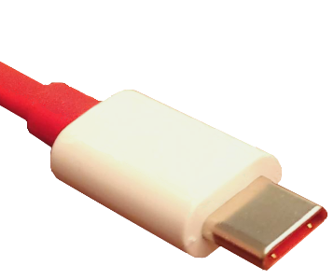
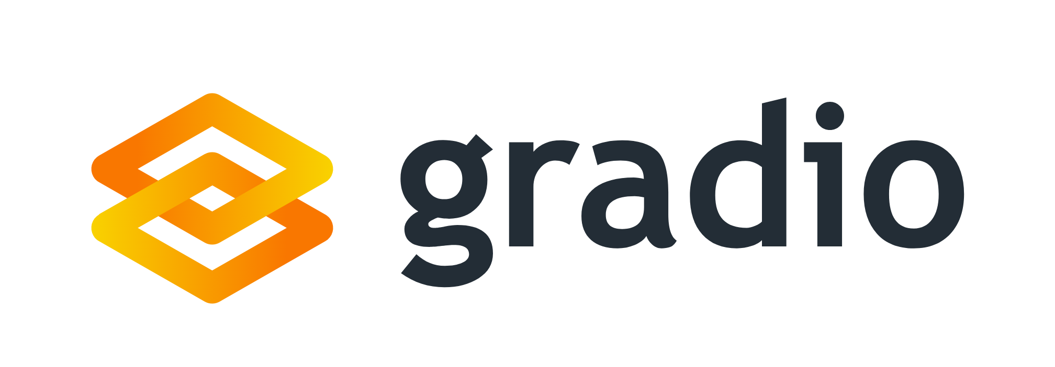

Project Overview
In this project, we will build an advanced AI tutor that adapts to your level and can summarize any concept, generate quizzes and flashcards.
This project will leverage Model Context Protocol (MCP), which is a standardized protocol that connects AI agents to various external tools and data sources.
Gradio MCP server
Create 10 Quiz Questions about Electric Vehicles
Quiz Creation Tool
MCP
© All rights reserved for Dr. Ryan Ahmed @Stemplicity Inc.
Summarization Tool
Explainer Tool
MCP is an open specification designed to be a standard way for models to discover & interact with tools. It’s like a universal plug adapter for AI tools!
Flash Card Generation Tool

Slide 3

Key Learning Outcomes
Learn the foundational components of the Model-Context-Protocol (MCP) framework and how they enable tool interoperability.
Transform the existing "Advanced AI Tutor" into an MCP-compatible tool by configuring it with mcp=True using Gradio.
Build and expose a new tool called the “Explain in new language" as an MCP service using Gradio.
Deploy Gradio apps as MCP servers, making their capabilities accessible through standardized endpoints.
Write Python code to act as an MCP client by discovering tool capabilities through manifests and remotely executing actions via HTTP requests.
Build an AI Agent using OpenAI Agents SDK that decides when and how to interact with external MCP tools.
© All rights reserved for Dr. Ryan Ahmed @Stemplicity Inc.

Slide 4
WHAT IS MCP?

Slide 5
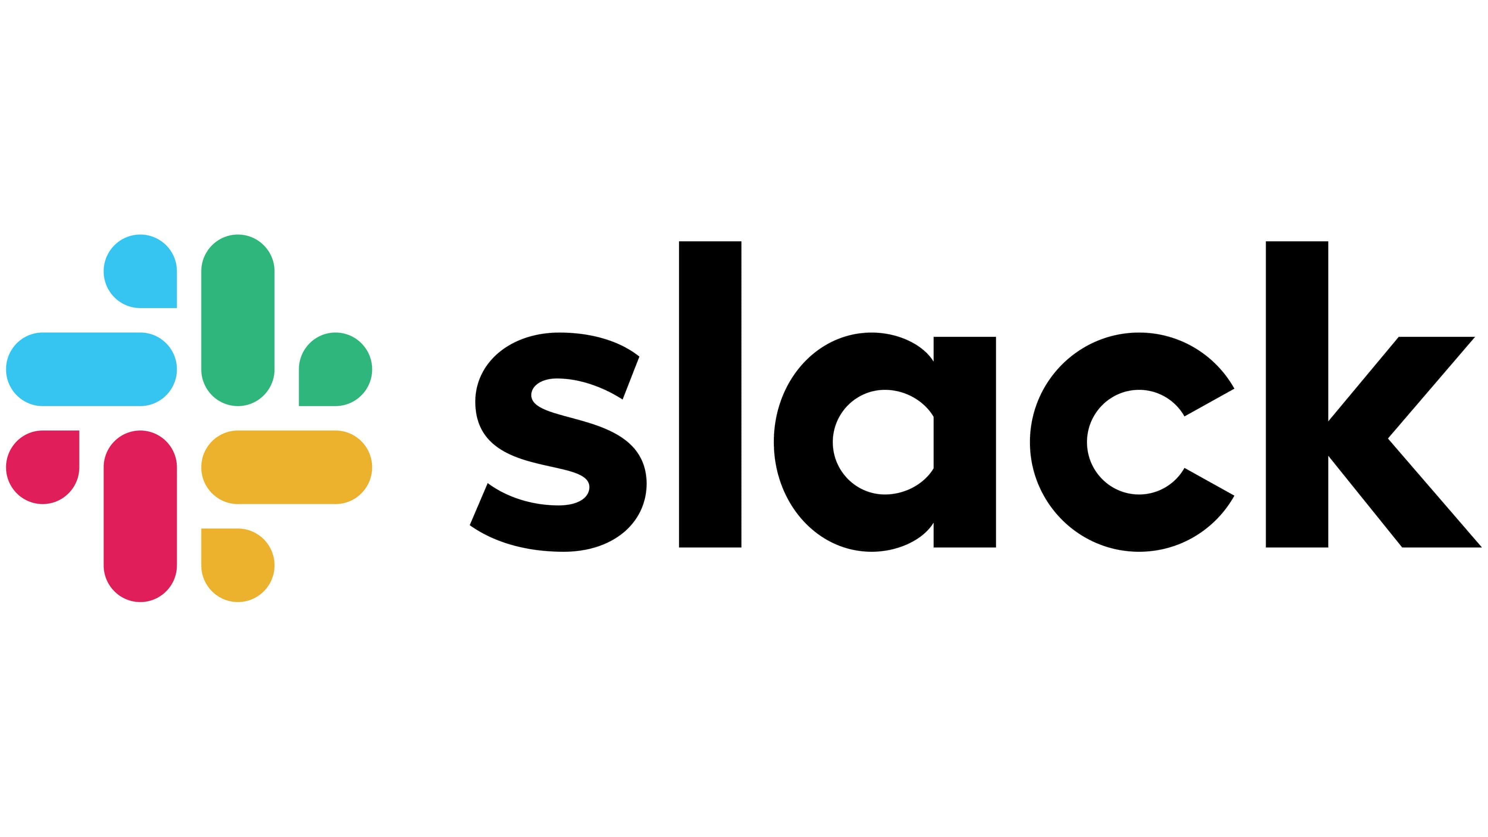
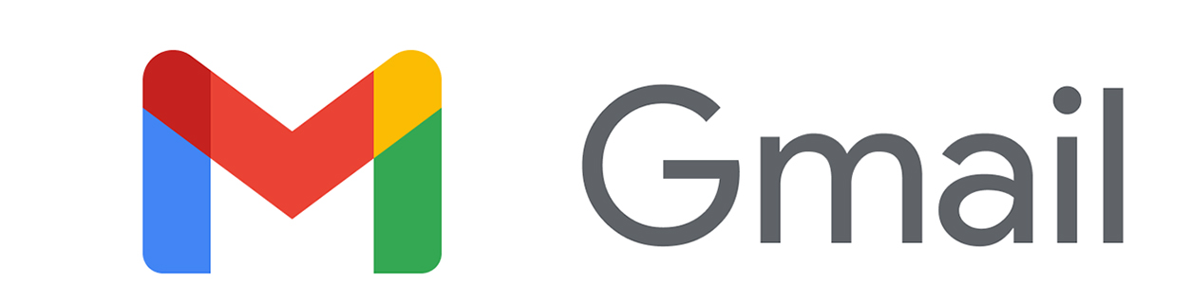
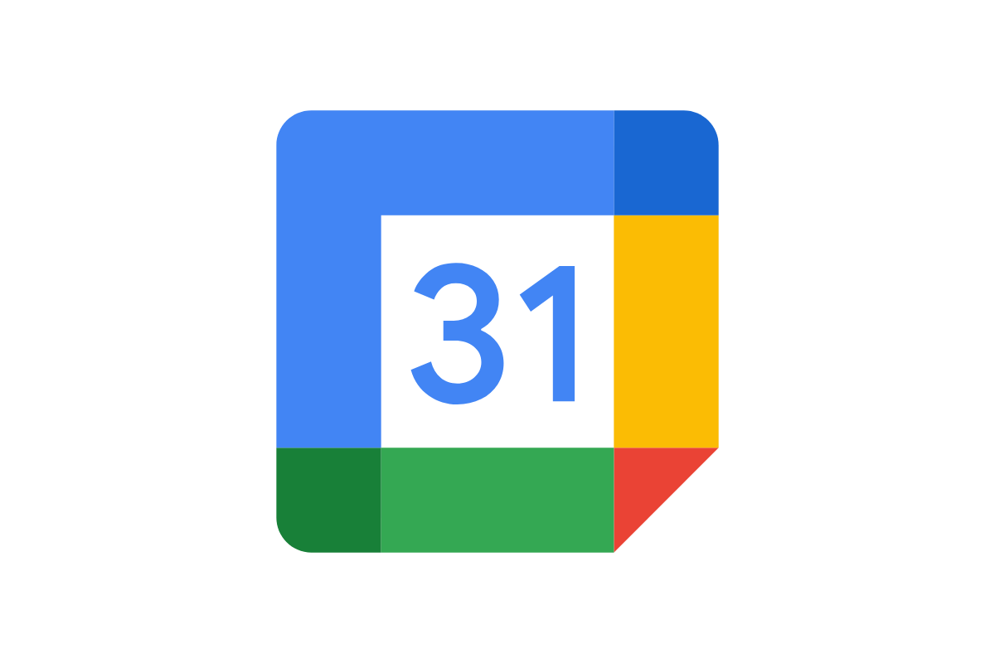

What is an MCP?
MCP is an open standard that lets AI models securely talk to tools, APIs, and data; it’s like a universal USB-C port for AI Applications.
MCP
AI Application
MCP
© All rights reserved for Dr. Ryan Ahmed @Stemplicity Inc.
MCP
MCP
Web APIs

Slide 6
Why MCP?
Tool Interoperability: Tools built with MCP can be discovered and used by any LLM that understands the MCP protocol.
Plug-and-Play AI Agents”: You can create tools (e.g. a sentiment analyzer or finance calculator) and "plug" them into AI agents with zero or minimal configuration.
Remote Execution: You can run tools as remote services (e.g. via HTTP) and have AI models call them like APIs.
Gradio Support: You can expose tools via Gradio interfaces with mcp=True, making it easy to turn existing apps into callable MCP tools.
Flexible Integration: Tools, workflows, & interfaces can all be swapped & recombined with minimal changes; like building with Lego blocks.
© All rights reserved for Dr. Ryan Ahmed @Stemplicity Inc.

Slide 7

Summary
Covered how the MCP framework facilitates seamless tool interoperability by standardizing how models, context, and protocols interact.
Learned how to transform existing tools into MCP-compatible services using Gradio.
Practiced deploying Gradio apps as MCP servers and writing Python clients that can dynamically discover tool capabilities and make remote calls through manifests and HTTP.
Explored how to create intelligent agents using the OpenAI Agents SDK that can autonomously decide when and how to utilize MCP tools based on task context.
© All rights reserved for Dr. Ryan Ahmed @Stemplicity Inc.

Slide 8
Thank you!

